Slide 1
ASU Presentation Test

Slide 2
Jalal Kiswani
Command: # Heading :
Description: This command add heading to the document
Example:
# Main Title
Output:
Include Screenshot of the output

Slide 3
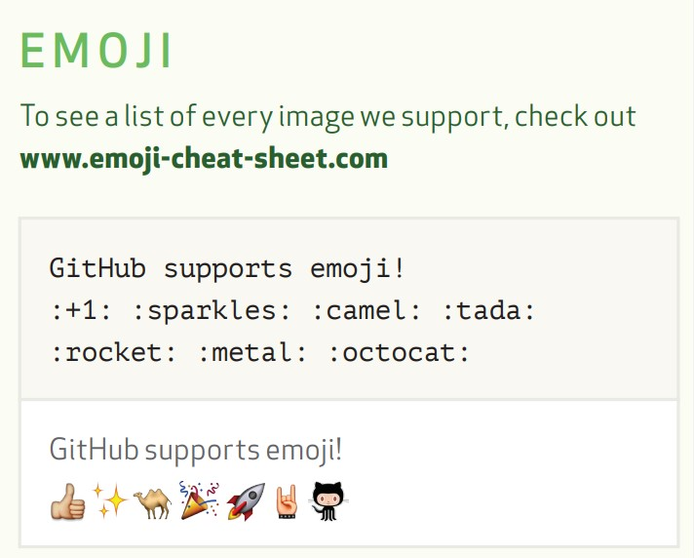
IBRAHIM MOHAMMAD
*****

Slide 4
Ahmad Abughbosh
Highlight
Command: ==Highlight==, Subscript
Example:
I need to highlight these ==very important words==
==ASU==
H~2~O
Results:
I need to highlight these very important words ASU
H₂O

Slide 5

Musaab
Strikethrough
~~The world is flat.~~
The world is flat.

Slide 6
Ahmad Mustafa
Command: Definition
Description: This command for explaining a definition
Example:
Term
: definition
Output:

Slide 7
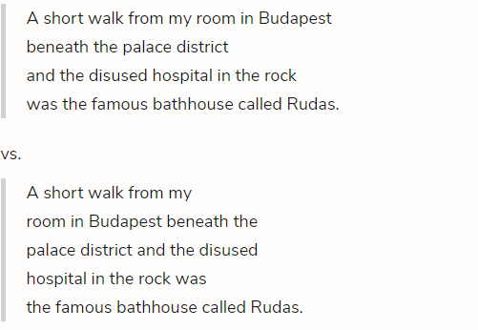
Khalifa Altawil
Command: (<br>)
Description: This command is
used to break lines.

Slide 8
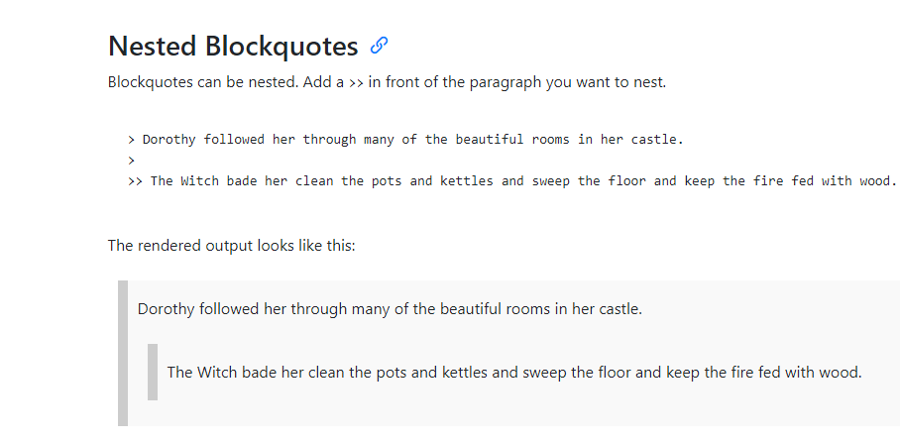
Mahmoud Samarah

Slide 9

Ahmad AbuZaid
Bold text (**( )**)
To bold text, add two asterisks or underscores before and after a word or phrase. To bold the middle of a word for emphasis, add two asterisks without spaces around the letters.
Ex: I just love **bold text**.
Output

Slide 10

Abdullrahman Ghazal

Slide 12

Ayman Harb
Command: Style
Description : change the style of the text
Example :
***Ayman Harb***
Output :

Slide 13
Athamneh
goat
يا هلا
Notes:
nothing

Slide 14
Jawad
Command :
Example :

Slide 15

Batool
Command: link
Example:[ASU](https://edugate.asu.edu.jo/)
OutPut:

